Slide 1
Lecture-4
Recurrence Relation

Slide 2


Slide 3

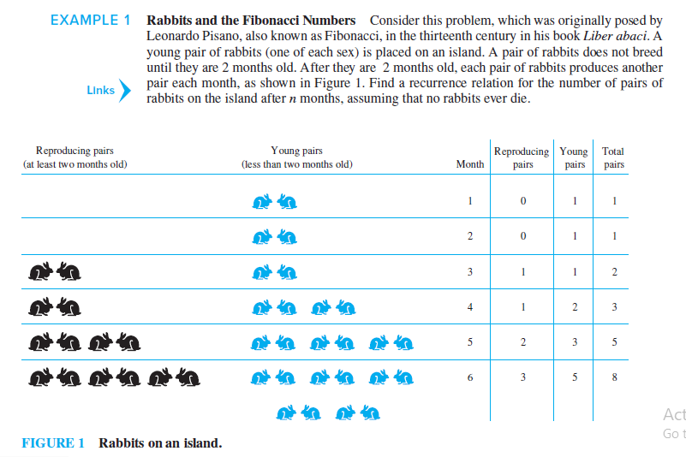

Slide 5
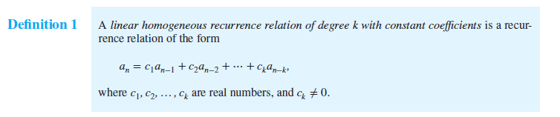


Slide 6


Slide 17


Slide 19


